Slide 1

APEX INSTITUTE OF TECHNOLOGY
DEPARTMENT OF COMPUTER SCIENCE & ENGINEERING
Database Management System (22CSH-243)
Faculty: Ms.Shaveta Jain (E13464)
ER Model
DISCOVER . LEARN . EMPOWER

Slide 2
DBMS: Course Objectives
COURSE OBJECTIVES
The Course aims to:
Understand database system concepts and design databases for different applications and to acquire the knowledge on DBMS and RDBMS.
Implement and understand different types of DDL, DML and DCL statements.
Understand transaction concepts related to databases and recovery/backup techniques required for the proper storage of data.

Slide 3
COURSE OUTCOMES
On completion of this course, the students shall be able to:-
CO2 | Design database for an organization using relational model

Slide 4
Unit-1 Syllabus
Unit-1 | Introduction to Databases and Relational Algebra
Overview of Databases: | Database concepts, DBMS, Data Base System Architecture (Three Level ANSI-SPARC Architecture), Advantages and Disadvantages of DBMS, Data Independence, DBA and Responsibilities of DBA, Relational Data Structure, Keys, Relations, Attributes, Schema and Instances, Referential integrity, Entity integrity.
Data Models: | Relational Model, Network Model, Hierarchical Model, ER Model: Design, issues, Mapping constraints, ER diagram, Comparison of Models
Relational Algebra & Relational Calculus: | Introduction, Syntax, Semantics, Additional operators, Grouping and Ungrouping, Relational comparisons, Tuple Calculus, Domain Calculus, Calculus Vs Algebra, Computational capabilities

Slide 5
Entity- Relationship Model
Entity-Relationship (ER) Model is based on the notion of real-world entities and relationships among them.
While formulating real-world scenario into the database model, the ER Model creates entity set, relationship set, general attributes and constraints.
ER Model is best used for the conceptual design of a database.

Slide 6
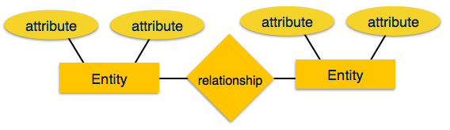
Entity- Relationship Model

Slide 7
Cont...
Types of Attributes
Simple attribute − Simple attributes are atomic values, which cannot be divided further. For example, a student's phone number is an atomic value of 10 digits.
Composite attribute − Composite attributes are made of more than one simple attribute. For example, a student's complete name may have first_name, middle_name and last_name.
Derived attribute − Derived attributes are the attributes that do not exist in the physical database, but their values are derived from other attributes present in the database. For example, average_salary in a department should not be saved directly in the database, instead it can be derived. For another example, age can be derived from data_of_birth.

Slide 8
Cont...
Types of Attributes
Single-value attribute − Single-value attributes contain single value. For example − Social_Security_Number.
Multi-value attribute − Multi-value attributes may contain more than one values. For example, a person can have more than one phone no.

Slide 9
Cont...
Relationships:
The association among entities is called a relationship. For example, an employee works_at a department, a student enrolls in a course. Here, Works_at and Enrolls are called relationships
Relationship Set
A set of relationships of similar type is called a relationship set. Like entities, a relationship too can have attributes. These attributes are called descriptive attributes.
Degree of Relationship
The number of participating entities in a relationship defines the degree of the relationship.
Binary = degree 2
Ternary = degree 3
n-ary = degree

Slide 10
Mapping Cardinalities
Cardinality defines the number of entities in one entity set, which can be associated with the number of entities of other set via relationship set.
Express the number of entities to which another entity can be associated via a relationship set.
Most useful in describing binary relationship sets.

Slide 11
Types of Relationship
One - One Relationship:- (1 – 1)
Each value in the first table could relate with only one record in the second table.
One – Many Relationship:- (1 - ∞)
Each value in the first table could relate with many records in the second table.
Many – Many Relationship (∞ - ∞)
Each value in the first table could relate with many records in the second table and each value of the second table could relate with many records in the first table.
Many – One Relationship(∞-1)
More than one entities from entity set A can be associated with at most one entity of entity set B, however an entity from entity set B can be associated with more than one entity from entity set A.

Slide 12
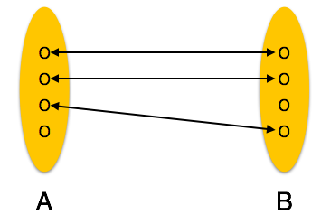
Cont...
One - One Relationship:- (1 – 1)
Each value in the first table could relate with only one record in the second table

Slide 13
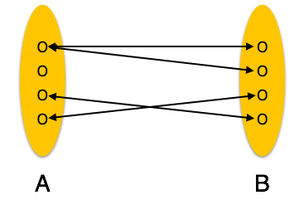
Cont...
One – Many Relationship:- (1 - ∞)
Each value in the first table could relate with many records in the second table.

Slide 14
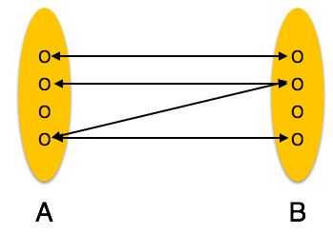
Cont...
Many-to-many − One entity from A can be associated with more than one entity from B and vice versa

Slide 15
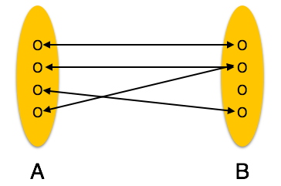
Cont...
Many-to-one − More than one entities from entity set A can be associated with at most one entity of entity set B, however an entity from entity set B can be associated with more than one entity from entity set A.

Slide 16
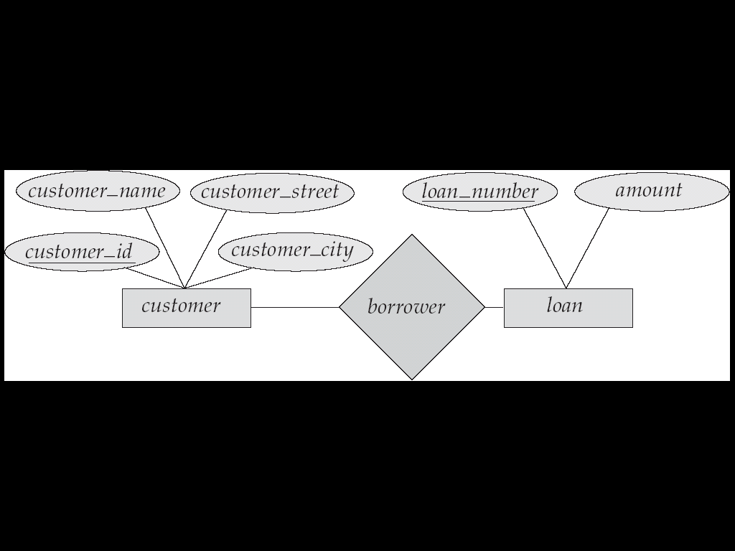
ER- Diagram
Rectangles represent Entity Sets.
Diamonds represent Relationship Sets.
Lines link attributes to entity sets and entity sets to relationship sets.
Ellipses represent Attributes
Double Ellipses represent Multivalued Attributes.
Dashed Ellipses denote Derived Attributes.
Underline indicates Primary Key attributes (will study later)

Slide 17
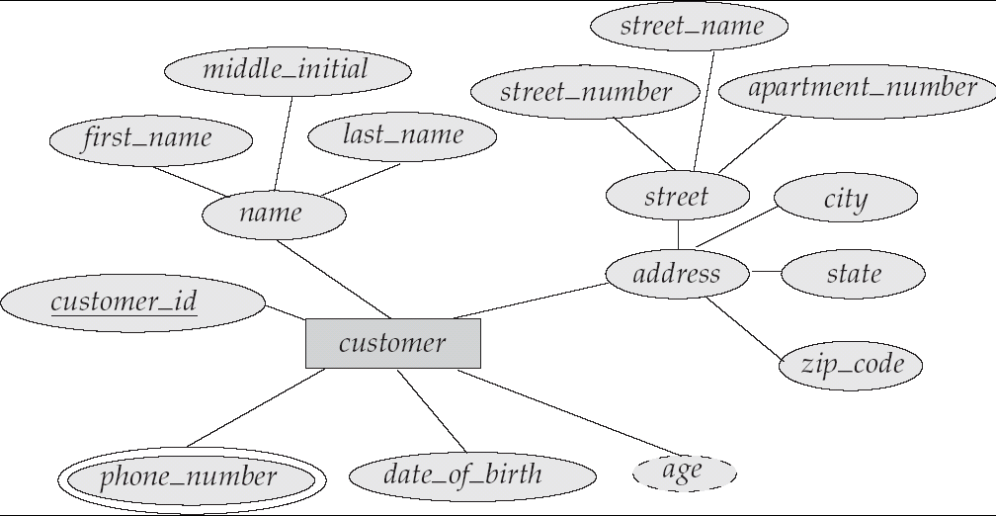
ER-Diagram with Composite, Multivalued and Derived value

Slide 18
Design Issues
Use of entity sets vs. attributes Choice mainly depends on the structure of the enterprise being modeled, and on the semantics associated with the attribute in question.
Use of entity sets vs. relationship sets Possible guideline is to designate a relationship set to describe an action that occurs between entities
Binary versus n-ary relationship sets Although it is possible to replace any nonbinary (n-ary, for n > 2) relationship set by a number of distinct binary relationship sets, a n-ary relationship set shows more clearly that several entities participate in a single relationship.
Placement of relationship attributes

Slide 19
Participation Constraints
Total Participation − Each entity is involved in the relationship. Total participation is represented by double lines.
Partial participation − Not all entities are involved in the relationship. Partial participation is represented by single lines.

Slide 20
Weak Entity Sets
An entity set that does not have a primary key is referred to as a weak entity set.
The existence of a weak entity set depends on the existence of a identifying entity set
it must relate to the identifying entity set via a total, one-to-many relationship set from the identifying to the weak entity set
Identifying relationship depicted using a double diamond
The discriminator (or partial key) of a weak entity set is the set of attributes that distinguishes among all the entities of a weak entity set.
The primary key of a weak entity set is formed by the primary key of the strong entity set on which the weak entity set is existence dependent, plus the weak entity set’s discriminator.

Slide 21
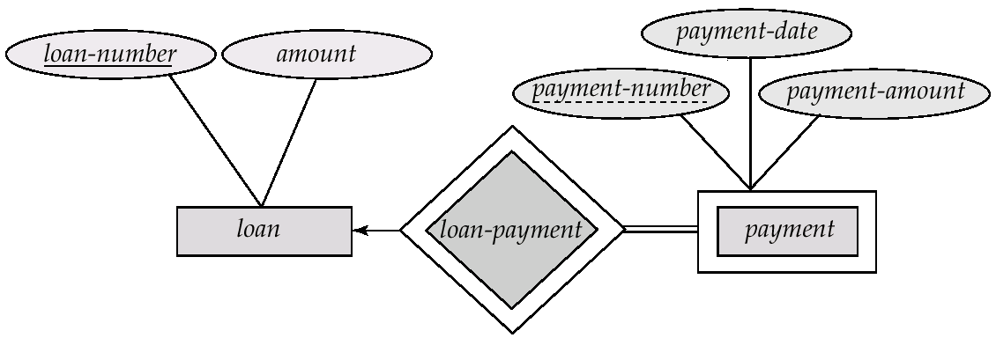
Weak Entity Sets (Cont.)
We depict a weak entity set by double rectangles.
We underline the discriminator of a weak entity set with a dashed line.
payment-number – discriminator of the payment entity set
Primary key for payment – (loan-number, payment-number)

Slide 22
Generalization and Specialization
The ER Model has the power of expressing database entities in a conceptual hierarchical manner.
Generalization:
Going up in this structure is called generalization (Bottom-Up), where entities are clubbed together to represent a more generalized view.
For example, a particular student named ‘Amit’ can be generalized along with all the students. The entity shall be a student, and further, the student is a person.

Slide 23
Generalization
A bottom-up design process – combine a number of entity sets that share the same features into a higher-level entity set.
Specialization and generalization are simple inversions of each other; they are represented in an E-R diagram in the same way.

Slide 24
Figure: Generalization
(Bottom-Up)

Slide 25
Specialization
Top-down design process; we designate subgroupings within an entity set that are distinctive from other entities in the set.
These subgroupings become lower-level entity sets that have attributes or participate in relationships that do not apply to the higher-level entity set.
Depicted by a triangle component labeled ISA (E.g. customer “is a” person).
Attribute inheritance – a lower-level entity set inherits all the attributes and relationship participation of the higher-level entity set to which it is linked.

Slide 26
Specialization Example
Similarly, in a school database, persons can be specialized as teacher, student, or a staff, based on what role they play in school as entities.
Figure: Specialization (Top-Down)

Slide 27
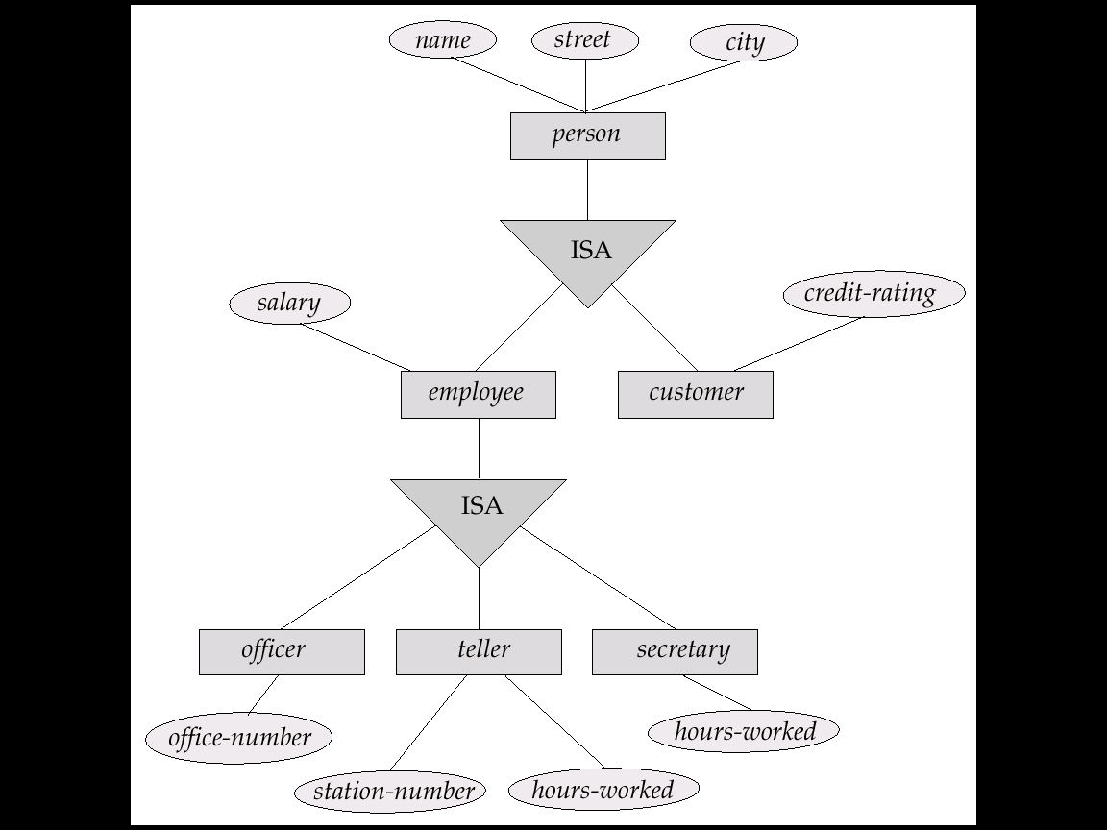
Specialization Example

Slide 28
Attribute Inheritance
We use all the above features of ER-Model in order to create classes of objects in object-oriented programming.
The details of entities are generally hidden from the user; this process known as abstraction.
Inheritance is an important feature of Generalization and Specialization. It allows lower-level entities to inherit the attributes of higher-level entities.
For example, the attributes of a Person class such as name, age, and gender can be inherited by lower-level entities such as Student or Teacher.

Slide 29
Figure: Inheritance

Slide 30
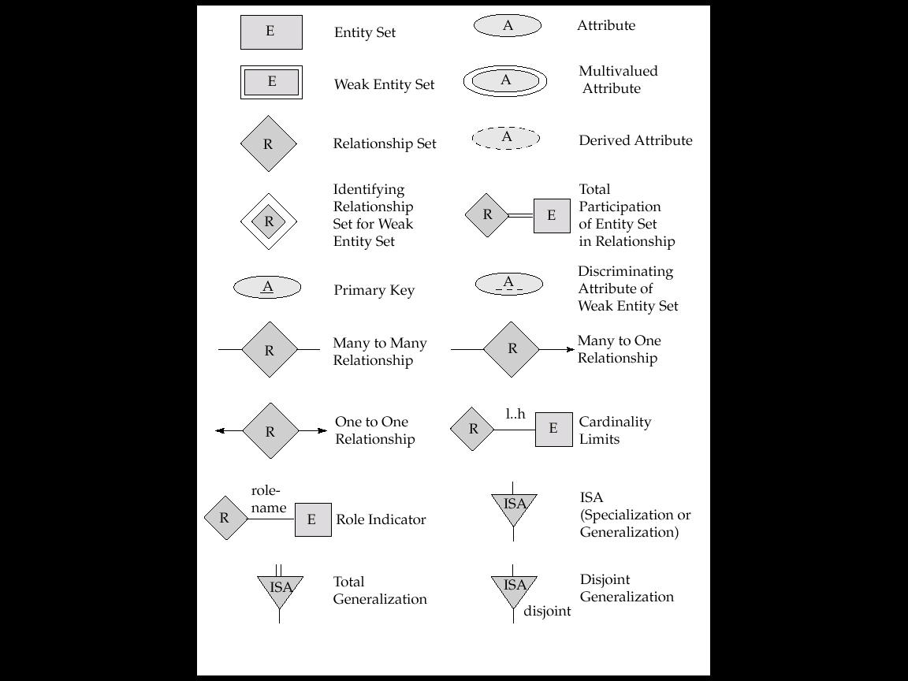
Summary of Symbols Used in E-R Notation

Slide 31
Summary of Symbols (Cont.)

Slide 32
E-R Design Decisions
The use of an attribute or entity set to represent an object.
Whether a real-world concept is best expressed by an entity set or a relationship set.
The use of a ternary relationship versus a pair of binary relationships.
The use of a strong or weak entity set.
The use of specialization/generalization – contributes to modularity in the design.

Slide 33
Summary
ER Model is based on the notion of real-world entities and relationships among them. While formulating real-world scenario into the database model, the ER Model creates entity set, relationship set, general attributes and constraints.
The model have some design issues discussed in the lecture.

Slide 34
FAQs
Explain ER Model
What are the design issues?
What are derived and multivalued attributes?
What is cardinality?
What are the different kind of relationships we have in ER Model?

Slide 35
References
RamezElmasri and Shamkant B. Navathe, “Fundamentals of Database System”, The Benjamin / Cummings Publishing Co.
Korth and Silberschatz Abraham, “Database System Concepts”, McGraw Hall.
C.J.Date, “An Introduction to Database Systems”, Addison Wesley.
Thomas M. Connolly, Carolyn & E. Begg, “Database Systems: A Practical Approach to Design, Implementation and Management”, 5/E, University of Paisley, Addison-Wesley.

Slide 36
THANK YOU
For queries
Email: shaveta.e13464@cumail.in

